Slide 1
Project on “SmartGrocery”
Grocery Shopping Never Been This Fun!

Slide 2
Contents
Page
Team information 3
Introduction of our project 4
Why our project ? 5
Benefits and Impacts 6
Reusability and Scalability 7
What is unique in our project ? 8
How it is going to work ? 9
Tools and Platform 10
Screenshots 11
Mapping of our project 12
ERD 13
Limitations of our project 14
Future scope and development of our project 15
Conclusion 16
Thank-You 17

Slide 3




Team Name - Tech Robust
Agniva Shil
B.tech 3rd year
Techno International New Town
agnivashil30@gmail.com
Sayan Roy
B.tech 3rd year
Techno International New Town
sayanroy0009@gmail.com
Akash Saha
B.tech 3rd year
Techno International New Town
mr.akashsaha574@gmail.com
Anik Adrish Majhi
B.tech 3rd year
Techno International New Town
anikadrish@gmail.com

Slide 4
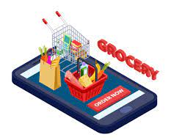
Introduction of our project
Online grocery shopping is becoming an integral part of life for more and more customers around the world and has truly change the way consumers acquire their groceries. nevertheless, the offline environment is Still a priority for most customers. therefore it is not surprising that new technologies are also being introduced in traditional stores. So here comes our SmartGrocery app. It is based on the concept of user interacted intelligence. The more the user uses this app, the efficiency of this app increases. Our app collects data from each users rating and review, relay this information to digital platforms and help more users about the availability of products and to make better decisions.

Slide 5
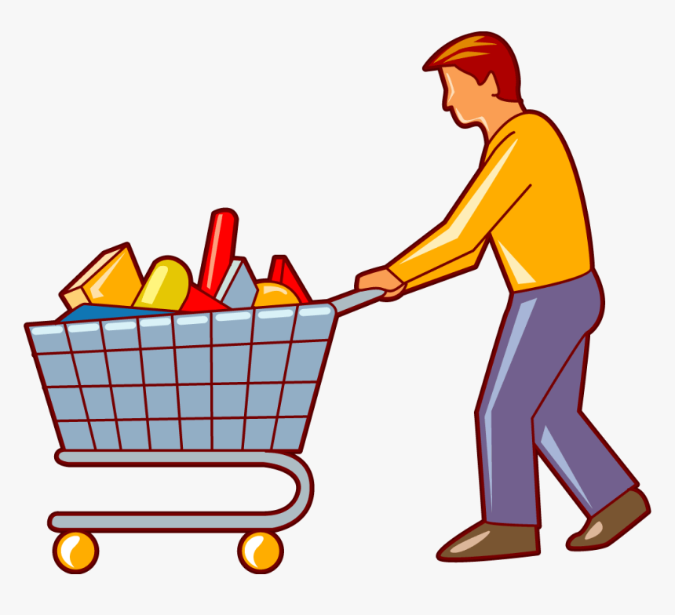
Why Our Project ?
We are creating this app with the intention of helping people to see the available products and compare the prices of small and mid range stores in local area excluding the malls and the showrooms. The user can decide exactly which store to go after seeing the availability and cost comparison , the datas will be fully based on other customers rating and reviews . and everyone can update the availability and cost details on the app. When the app gets certain amount of similar responses from many customers, it’ll get it as correct details and update the details on the app.

Slide 6

Benefits and Impact
1. It improved offline go and buy experience from the local area stores.
2. In local area shop and open markets the prices are different some time and the quality also differs, our app will help people to go to the right shop of their choice where they can get the best quality product and in fair price also, depending upon the ratings and reviews by the customers.
3. At the grocery store, the goods might have been on the shelves for a day or two, you get the picture because the buyers will rate and review the item in our app, if anyone see the rating and review then can know exactly which store to go and buy the fresh product!

Slide 7
Reusability and Scalability
Our app will be analyzing ratings and reviews from many customer and use the data to deliver the best optimal solution to choose the best available product in fair price.
It’ll save the time of those who prefer to go offline and buy product from local area shops.
It’ll save huge time for those who are searching for a specific product in local area , so instead of searching for a while in offline they can simply search in the app and they can find the product just in a snap if the product is available nearby.

Slide 8


What is unique in our app ?
The current apps doesn’t cover the offline local stores and open market product. Here our app takes the lead and do covers the local shops and their products stock. This will reduce the time as well as the price and quality factors between many shops in local area.The offline go and buy never been so easy!

Slide 9
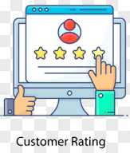
How it is going to work ?
So you maybe thinking about how our app is going to collects the data and how it’ll going to verify if the details of the stores and the products are true .
Our app will analyse from the customer rating and reviews, and after getting same type of information from a certain amount of customers it’ll receive it as correct and will be updating the data on app.
And about the shops rating system we will have a customer review page where they can give their feedback according to their opinion. If a store receives more than 50 reviews then its rating is 2 If a store receives more than 100 reviews its rating is 3 If a store receives more than 500 reviews its rating is 4.

Slide 10
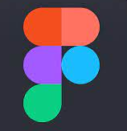





Tools and Platform
Figma
Draw.io
Java
Android Studio
Google Firebase
Github

Slide 11
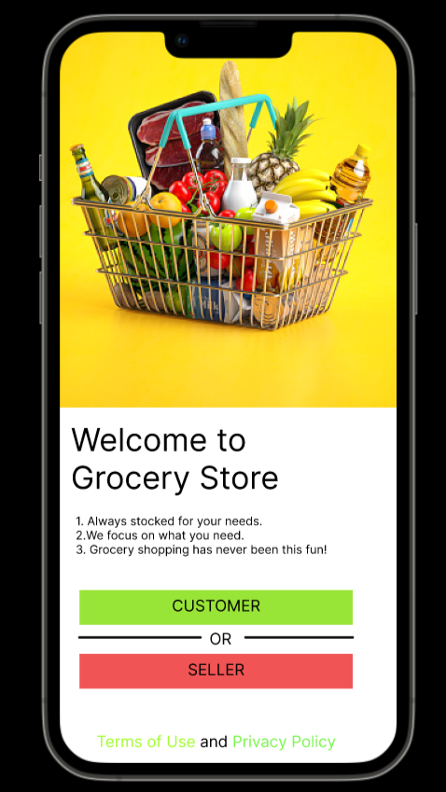
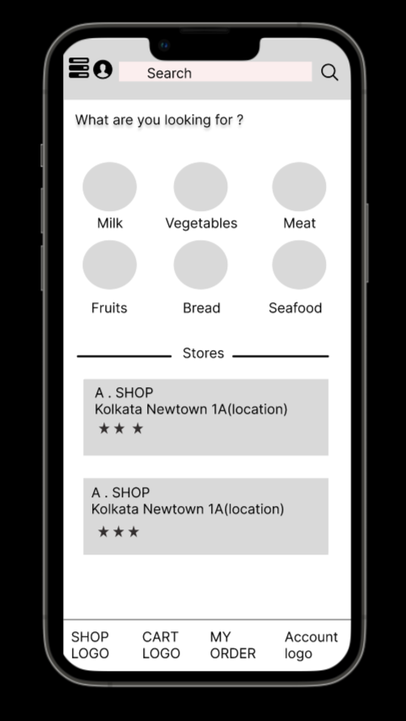
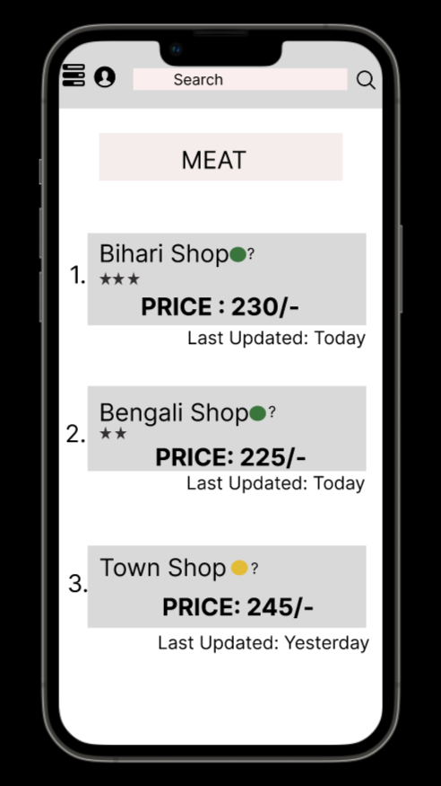
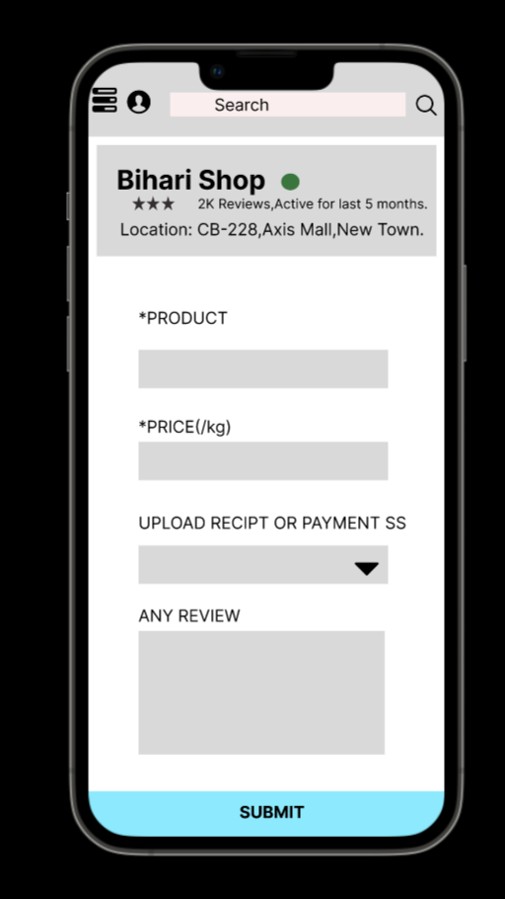
Some Screenshots of Our Prototype

Slide 12
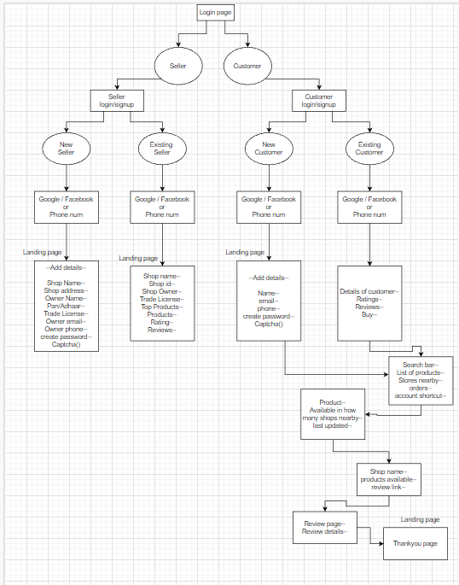
Mapping of our Project

Slide 13
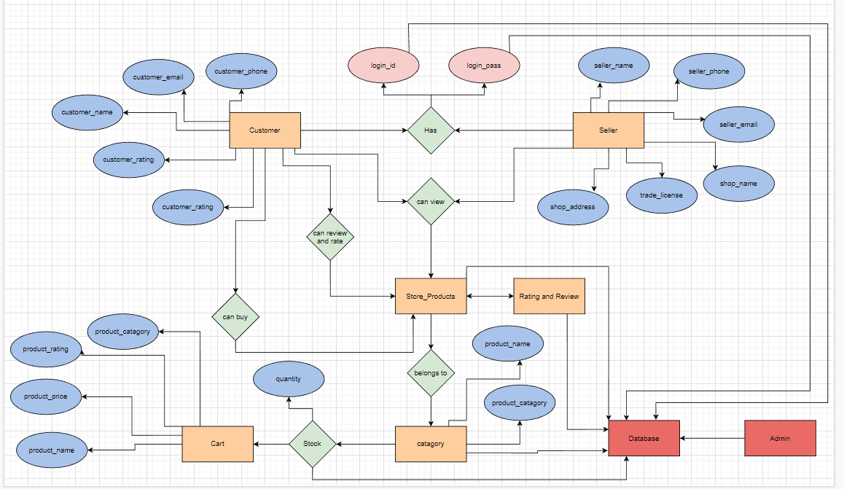
ERD of SmartGrocery

Slide 14
Limitations of our project
The only limitation it can have is , things are getting online and people might prefer online grocery markets like blinkit or BigBasket but still when it comes to buy fruits or vegetables people prefer buy it by visiting stores which give them better customer satisfaction in comparison to online. People prefer to have a morning walk while buy all the needs for the whole day. This is how it can serve the purpose of our customer through which they can buy these things more conveniently and have a exposure outside their home which refreshes our mind.

Slide 15
Future scope and development of our project
The market India have , small stores plays a big role , if they can be commercialized through our application, the purpose of seller and customer can be met both at a time. The ratings of the stores decide how quality items they delivers which will be verified by the customers.
In this way , a quality market around the city can be maintained where seller main target would be provide quality items and get more reviews from the customer and increase the rating.
Also customers don’t need to go here and there for searching particular item as item in the store if specified will already be shown to them which saves their time and increase productivity around.

Slide 16
Conclusion
In the digital world, nothing can flourish without the influence of technology and the internet. Social media is also a place to impress your consumers and get them to shop at your store. The store can be anywhere, online marketplace or offline Kirana store and supermarket. In general stores or the Kirana store, a consumer can collect his groceries at his own convenience.
Thus through our app the purpose of customer and seller can be met and a healthy and productive market can be formed around which aims providing quality items and get verified by their customers.The more the audience it will get the more intelligent it will get with time which adds a great value to this sector for our innovative future.

Slide 17
“
Thank You
,,

